Slide 1


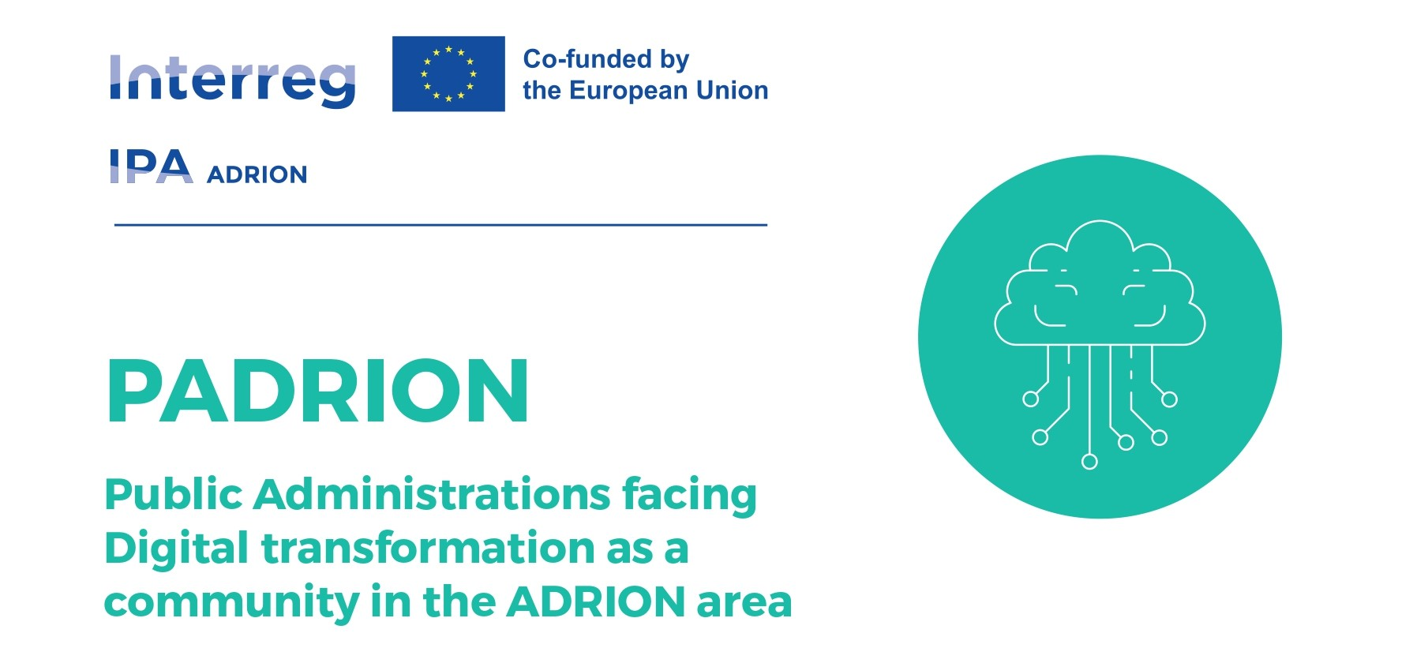

Bridging the Digital Divide: Practical Tools for Egaleo and the ADRION Network
Digital Solutions for Vulnerable Groups Inclusion
Enhancing digital skills in public services and supporting vulnerable communities through the PADRION Project Framework
PADRION meeting - in person
EGALEO-ASDA
December 2-3, 2025
Eirini Mantzouni - eirini.mantzouni@quantos-stat.com
Christos Angelidis - christos.angelidis@quantos-stat.com

Slide 2

Take Home Messages
Digital tools should be enablers, not barriers — technology must serve people, not exclude them
Inclusion operates at two levels: citizens (especially vulnerable groups) AND municipalities (especially smaller ones)
"Nothing About Us Without Us" — co-design with vulnerable groups is essential for success
Technology alone is not enough — human support, training, and trust are equally important
Don't reinvent the wheel — learn from proven European practices and adapt them locally
Transnational cooperation multiplies impact — sharing knowledge across borders benefits everyone
Quantos offers practical solutions: data analytics, assessment tools, AI-powered recommendations, and accessibility expertise to support PADRION's digital inclusion goals

Slide 3
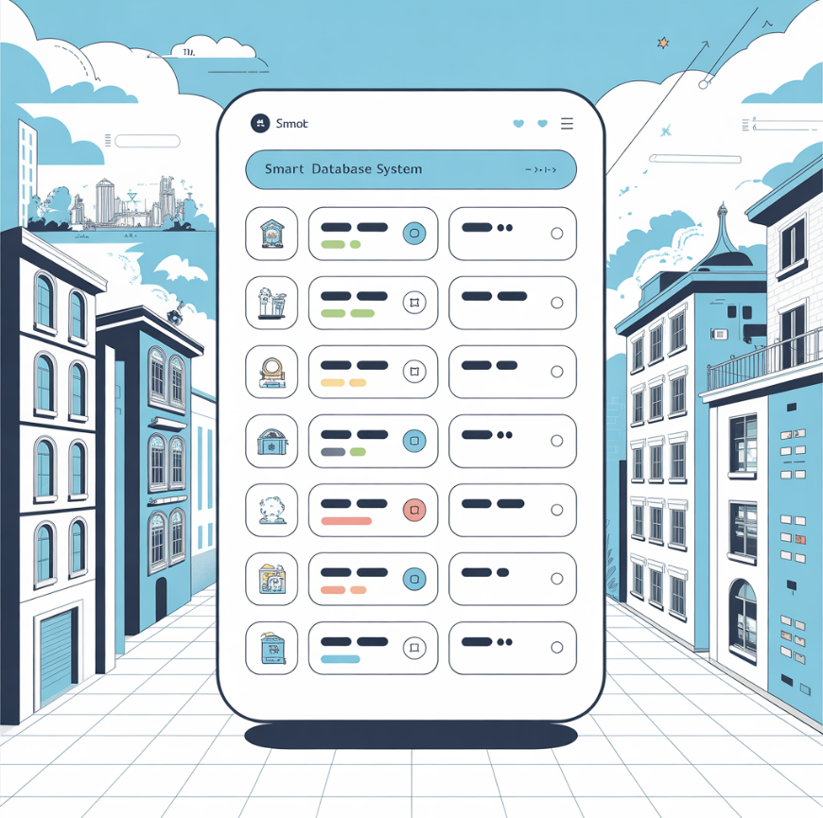
Structure
Who we are - QUANTOS
European Best Practices: Lessons from Barcelona, Helsinki, Amsterdam, Bordeaux
EU Projects: SHIFT, ARCHES, and Accessible Cultural Heritage
Proposed Solutions for PADRION:
Data & Analytics Tools
Assessment Frameworks
Good Practices Matching
AI-Powered Recommendations
The PADRION Digital Transformation Toolkit
Benefits for the Municipality of Egaleo and PADRION
Next Steps & Call to Action

Slide 4





Quantos: Data Analytics & Official Statistics Excellence
Quantos is a Greek data analytics and statistics company established in 1997, specializing in the complete lifecycle of information—from specification through compilation, processing, analysis, and dissemination.
With offices in Athens, we serve clients worldwide including
European Commission,
African Development Bank,
OECD, and Bank of Greece.

Slide 5

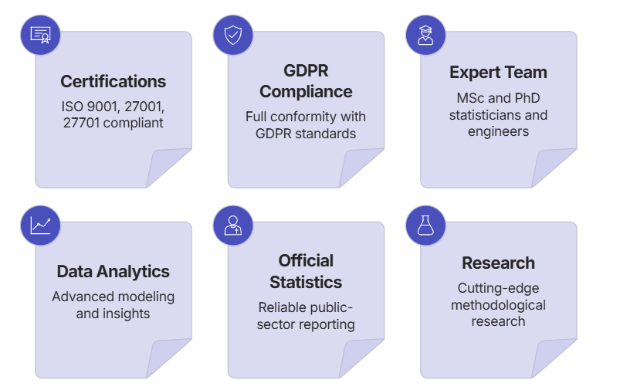
Our Core Services & Innovations
Data Analytics
Official Statistics
AI-powered data compilation, textual analysis with NLP, web scraping, and advanced visualization solutions for public and private sectors.
Complete survey lifecycle services—from sampling design through data collection, validation, analysis, and dissemination portal development.
Privacy Protection
The "Quantile at Risk" (QaR) method assesses re-identification risk in anonymized data, recognized by AFNOR (Z90-030) and CEN standards.

Slide 6

Featured Projects & Global Impact
European Commission Projects
Global Partnerships
Semantic Analysis & NLP: Built statistical knowledge databases with AI/ML techniques for improved data service experiences
Bank of Greece: Monthly Tourism Balance of Payments compilation since 2003
Fair Transition Monitoring: AI tool compiling qualitative information on climate neutrality policies and their societal impacts
African Development Bank: Gender data portal for African statistics with Bill Gates Foundation funding
She Figures 2018-2024: Flagship publication on gender equality in research and innovation across Europe
PES Benchmarking: Dynamic dashboard for EU Public Employment Services performance indicators
Food Price Monitoring: Web-based indicators tracking price developments across food production chains
Innovation Union Database: Maintenance and development
of EU competitiveness indicators

Slide 7
The Digital Divide: A European Challenge
The urgency for digital inclusion solutions is underscored by stark European data that reveals significant gaps in digital access and skills across vulnerable populations.
46%
49.94%
12.24%
76.26%
EU Citizens Lack Basic Digital Skills
Seniors Use E-Government
Elderly Use Online Education
Elderly Now Online
Up from 61% in 2020, but gaps remain in meaningful use
Approximately 205 million people across Europe
Citizens aged 65+ compared to 70% general population
Compared to 33% of general population
Countries with highest digital exclusion rates include Romania, Greece, and Bulgaria.
These statistics demonstrate that vulnerable groups face compounding barriers: lack of access, insufficient skills, and services not designed for their needs.
Sources: Eurofound (https://www.eurofound.europa.eu/),
European Commission Digital Decade Report (https://digital-strategy.ec.europa.eu/)

Slide 8
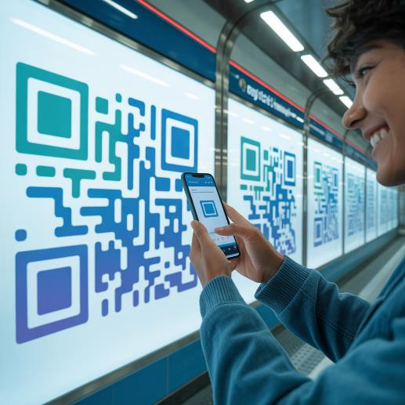
Barcelona's NaviLens: Navigation for All
Barcelona has pioneered the use of NaviLens, a color-coded QR system specifically designed for blind and visually impaired people.
This innovative technology has been implemented across the city's metro and bus system, with codes at entrances, platforms, and ticket machines.
Key Features:
Codes can be scanned from up to 12 meters away without precise focusing
Information delivered in 33 languages through audio, sign language video, or easy-read text
Archaeological Museum of Murcia uses NaviLens for exhibit information and indoor navigation
Recognized with multiple European innovation awards

Slide 9
Helsinki: Combining Technology with Human Touch
Home Digital Support
24/7 Chatbot Assistance
Free home visits by volunteers to help seniors with digital issues. Developed jointly by the City of Helsinki and HelsinkiMission since 2021, winning the Digitukiteko 2025 award.
Sotebotti Hester chatbot provides round-the-clock guidance on health and social services, ensuring help is always available.
Proxy Access System
Community Support Network
Maisa client portal allows caregivers to act on behalf of vulnerable individuals with proper consent tracking.
Digital support available at libraries, community centers, service centers, and adult education facilities throughout the city.

Slide 10
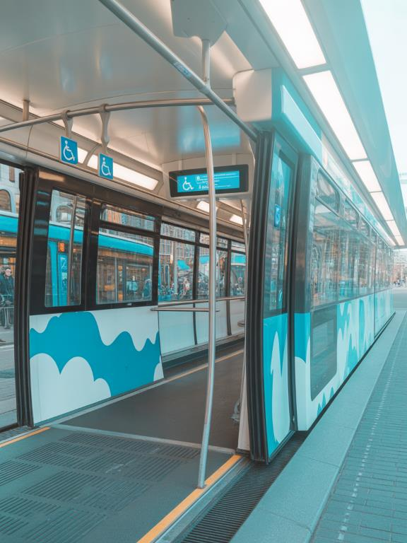
Amsterdam's Integrated Accessibility Ecosystem
Amsterdam provides a comprehensive digital and physical accessibility ecosystem that serves as a model for integrated services. The GVB Travel App features "Accessible Journey" and "Less Walking" route options, with a virtual stop assistant helping visually impaired travelers find accessible stops.
01
Accessible Transport
AOV taxi service with app booking for people with mobility disabilities
02
Digital Permits
Online parking permit system for disabled residents
03
Mobility Support
WMO Helpdesk digital application for wheelchairs and home modifications
04
Venue Mapping
Accessible Amsterdam and Able Amsterdam websites mapping accessible
venues citywide

Slide 11

Bordeaux Métropole: A Comprehensive Model
Serving 800,000+ residents across 28 municipalities, Bordeaux has created a comprehensive municipal model that delivers 20,000+ individual assistance sessions per year and trains 5,000+ people annually.
Public Digital Space
Professional Training
France Service Advisors
Free access to computers, tablets, and internet with professional digital mediators and multilingual support staff.
Individual appointments for digital support with help for government forms, banking, job searching, and family communication.
Social workers, employment counselors, and library staff trained to assess digital literacy and provide appropriate support. Understanding different needs by vulnerable group with resources and referral networks.
Specialized professionals assisting citizens with online administrative procedures. Ongoing support distributed across the metropolitan area, not just one-time workshops.

Slide 12

SHIFT Project: AI for Accessible Cultural Heritage
A €3.2 million EU Horizon 2020 project using artificial intelligence to make museums accessible to people with disabilities. Successfully piloted at museums in 5 countries with positive feedback from users with disabilities.
Innovative Technologies:
Computer vision toolkit with automatic image tagging and alt-text generation
Emotional audio descriptions with inflection matching content
Haptic gloves allowing blind visitors to "feel" digital 3D models
Emotion recognition for personalized exhibit experiences

Slide 13




ARCHES: Nothing About Us Without Us
A €2.95 million project built on the principle of co-design with disabled people throughout development, not just testing at the end. Tools implemented in 15+ museums across Europe with 90%+ user satisfaction.
3D Tactile Reliefs
Barrier-Free Apps
3D scanning of artworks converted to tactile format. Blind visitors can "see" paintings through touch without risking originals.
Full screen reader compatibility with voice control, high contrast modes, and adjustable text.
Sign Language Avatars
Accessible Games
Computer-generated signing avatars in multiple national sign languages, available 24/7.
Multiple interaction methods with adjustable difficulty levels compatible with assistive technologies.

Slide 14




Key Lessons from European Practice
Combine Digital with Human Support
Technology alone is insufficient; volunteer programs, trained staff, and physical contact points remain essential.
User-Centered Design
Involve vulnerable groups in development from the start. "Nothing About Us Without Us" should guide all solutions.
Multi-Channel Delivery
Offer services through apps, websites, phone, video, and in-person to reach all users.

Slide 15




ADRION Digital Maturity Assessment (ADMA)
An adaptation of existing digital maturity frameworks specifically tailored for Adrion municipalities, measuring 10 dimensions including cultural heritage digitalization, coastal governance, and vulnerable groups inclusion.
Self-Assessment
Expert Assessment
Duration: 30 minutes
Duration: 1-2 days
50 yes/no questions online with instant score and 5-page report
On-site interviews and audit, 50-page report with roadmap workshop
1
2
3
Detailed Assessment
Duration: 2-3 hours
150 questions with evidence uploads, 30-page report with action plan
Beginner (0-30)
Basic or no digital services
Intermediate (31-50)
Some services, ad-hoc approach
Advanced (51-70)
Systematic approach, many services
Pioneer (71-100)
Data-driven, innovative, inclusive

Slide 16
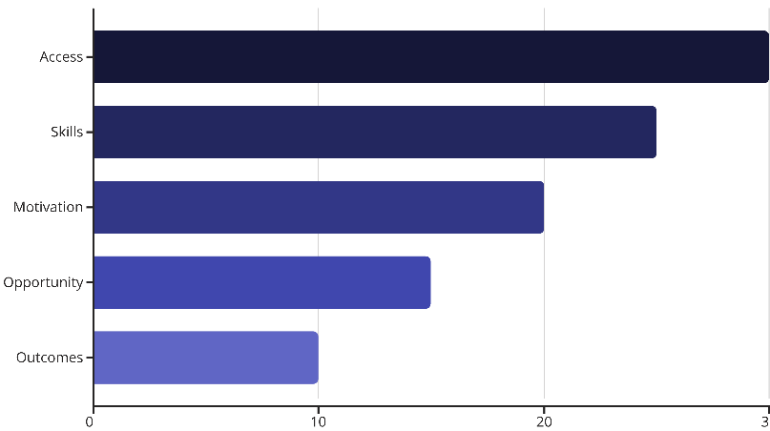
Vulnerable Groups Digital Inclusion Scanner
A specialized assessment tool measuring digital inclusion gaps across 8 target populations: elderly, people with disabilities, migrants, low-income households, rural residents, women, long-term unemployed, and low-literacy adults.
The scanner produces an inclusion score by group (0-100), prioritized intervention recommendations, cost estimates for closing gaps, comparison to regional benchmarks, and an interactive dashboard for tracking progress.
Notes:
The Vulnerable Groups Digital Inclusion Scanner is a specialized assessment tool that measures digital inclusion gaps across 8 key target populations. These groups include the elderly, people with disabilities, migrants, low-income households, rural residents, women, long-term unemployed, and low-literacy adults. The scanner evaluates digital inclusion across 5 key dimensions: access, skills, motivation, opportunity, and outcomes. Each dimension is weighted, with access being the most heavily weighted at 30%. The scanner produces an inclusion score for each group on a 0-100 scale, as well as prioritized intervention recommendations and cost estimates for closing the gaps. It also provides comparisons to regional benchmarks and an interactive dashboard for tracking progress over time. This comprehensive assessment can help organizations and policymakers better understand and address digital inequities within vulnerable communities.

Slide 17
Progress Dashboard: Real-Time Network Insights
Real-time visualization of PADRION network's collective progress with 50+ KPI indicators across five categories:
Digital Maturity, Local Digital Agendas, Vulnerable Groups, EU Funding, and Community Engagement.
Network Overview
Interactive Map
Comparative Analysis
Hero numbers, trends, and leaderboards showing collective progress
Color-coded visualization by maturity level across the region
Benchmark against similar municipalities
Time Series Analysis
Thematic Deep-Dives
Historical trends and forecasts
Detailed analysis per vulnerable group

Slide 18








Good Practices Matcher: Smart Solution Discovery
A smart database connecting municipalities with proven, replicable solutions through 15 search and filtering categories, including municipality size, geography, digital maturity level, challenge type, target group, budget range, and technology type.
Search & Filter
AI Matching
Find practices matching your context
Auto-suggest 10-15 most relevant practices
Track Results
Replication Guide
Monitor outcomes and share learnings
Step-by-step process with resources
The matching algorithm weighs profile similarity (85%), challenge alignment (80%), resource availability (75%), and replication ease (70%) to provide the most relevant recommendations.

Slide 19



AI-Powered Intervention Recommender
AI-powered system that matches identified gaps with proven interventions, analyzing specific barriers and ranking solutions by impact potential, feasibility, and cost-effectiveness.
Youth Volunteers
Example Scenario:
Teach elderly 1-on-1 at home
Gap Identified: 65% of elderly lack basic digital skills, confidence low
Barrier Analysis: No nearby training, fear of technology, no family support
Curriculum
WhatsApp, banking, e-government, video calls
Recommended Intervention: "Digital Ambassadors" Program
Expected Outcome
70% improve skills by 2 levels

Slide 20

Cultural Inclusion Platform Features
A mobile app or web platform with built-in accessibility features for cultural events, designed to break down barriers and enable full participation for all citizens.
Accessibility First
Virtual Access
Communication Support
Screen reader compatibility, text-to-speech, high contrast modes, simplified navigation, and multi-language support
Live streaming of events, on-demand video archives with captions, virtual museum tours, and 360-degree experiences
Sign language interpretation in videos, real-time captioning services, audio descriptions for visual art

Slide 21

Volunteer Companion Service
A comprehensive matching system connecting trained volunteers with individuals needing accompaniment to cultural events, ensuring no one is excluded from cultural participation.
1
Profile Creation
Volunteers and beneficiaries create profiles with preferences, availability, and needs
2
Smart Matching
Algorithm considers proximity, language, training certifications, and compatibility
3
Confirmation
Both parties review match and confirm participation with reminders
4
Event Support
Navigation assistance, communication tools, and emergency contacts
5
Feedback Loop
Post-event ratings and feedback improve future matches

Slide 22

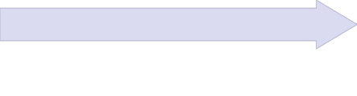

Implementation Framework: Phased Approach
Phase 3: Maturation
Phase 2: Expansion
Phase 1: Foundation
Predictive analytics models, advanced AI features, platform integrations, and sustainability planning for long-term operation.
Full ADMA with all 3 assessment levels, comprehensive Scanner with surveys, Good Practices Matcher with AI recommendations, full Dashboard with all KPIs, and complete Replication Toolkit.
Deploy ADMA self-assessment tool, launch Vulnerable Groups Scanner (rapid version), establish Good Practices database with 30 initial practices, and create basic Progress Dashboard.

Slide 23

Benefits for the Municipality of Egaleo
As a PADRION partner focused on digitization for vulnerable groups and culture, Egaleo stands to gain concrete benefits from these digital solutions.
Evidence-Based Planning
Baseline measurement of current digital maturity, specific data on digital exclusion among vulnerable residents, prioritized action recommendations based on local gaps, and benchmarking against similar municipalities.
Access to Proven Solutions
Find solutions already tested in cities like Barcelona, Helsinki, Amsterdam, and Bordeaux. Filter by budget, timeline, and target group relevant to Egaleo's context with step-by-step replication guides.
Measurable Progress
Real-time tracking of digital inclusion improvements, visibility across PADRION network for shared learning, data for reporting to EU funders, and evidence of impact for vulnerable citizens.
Network Effects
Peer learning from 9 partner organizations across 7 countries, shared resources and expertise, collective voice in EU digital inclusion policy, and potential for joint funding applications.

Slide 24








Expected Outcomes for Egaleo Citizens
Elderly Residents
People with Disabilities
Improved access to municipal e-services, digital literacy training opportunities, volunteer companion support for cultural participation
Accessible municipal website and services, cultural venues with digital accessibility features, communication aids including sign language and audio description
Low-Income Households
Migrants & Refugees
Community Digital Hubs with free access, simplified service portals reducing barriers, cost-saving through online service access
Multi-language digital services, culturally appropriate training materials, integration through cultural participation

Slide 25



Next Steps: From Vision to Action
1
Assess
Complete ADMA self-assessment to establish baseline digital maturity
2
Scan
Deploy Vulnerable Groups Scanner to identify priority populations and specific needs
3
Match
Use Good Practices database to find relevant interventions tested in similar contexts
4
Plan
Generate Local Digital Agenda using the Builder tool with customized objectives
5
Implement
Pilot selected solutions with PADRION partner support and technical assistance
6
Track
Monitor progress through the Dashboard and adjust strategies based on data
7
Share
Contribute learnings back to the PADRION network for collective benefit
By participating actively in PADRION, Egaleo can become a model for digital inclusion in Greece and the wider Adriatic-Ionian region—ensuring that digital transformation truly serves all citizens, especially the most vulnerable.

Slide 26

The Future is Inclusive — Thank You

